Slide 1











THE PROCESS OF WRITING
BY: GENESIS MEDINA

Slide 2
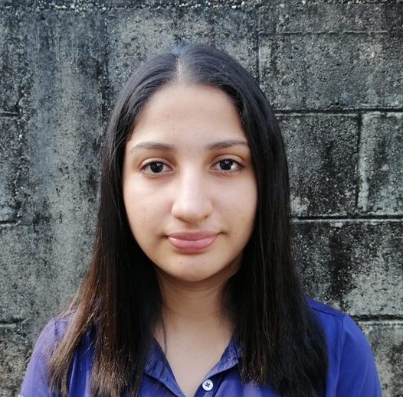



ABOUT ME
HELLO EVERYONE! MY NAME IS GÉNESIS MEDINA, I LIVE IN PUERTO CORTÉS AND I’M CURRENTLY STUDYING COMPUTER ENGINEERING. IN MY FREE TIME, I LOVE TO BAKE DESSERTS, WATCH ANIME AND RECENTLY I'VE STARTED EXERCISING. I'M THE ELDEST OF THREE BROTHERS. I’M EXCITED TO BE IN THIS CLASS AND LOOK FORWARD TO LEARNING ABOUT MORE THINGS WITH ALL OF YOU!

Slide 3


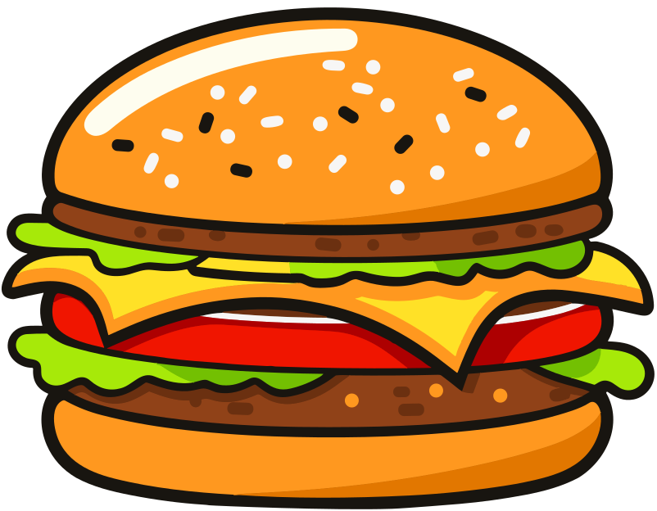
IF YOU HAD TO EAT ONE FOOD FOR THE REST OF YOUR LIFE, WHICH ONE YOU CHOOSE?
If I had to eat one food for the rest of my life, I would choose a hamburger with french fries. It’s a simple but delicious meal that I never get tired of. The burger can have different ingredients like cheese, lettuce, or sauces, so it feels like a new meal every time. The fries are crispy and go perfectly with the burger. Together, they make a meal that is tasty and satisfying, and I could enjoy it every day without getting bored.
- Génesis Medina

Slide 4
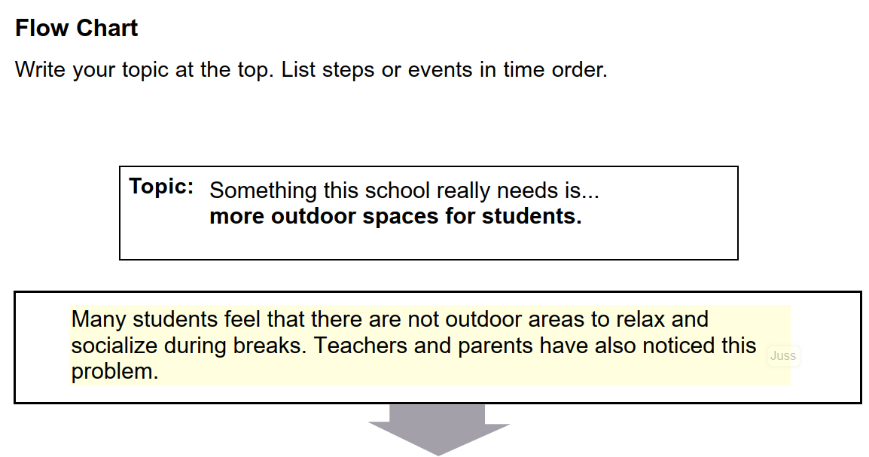
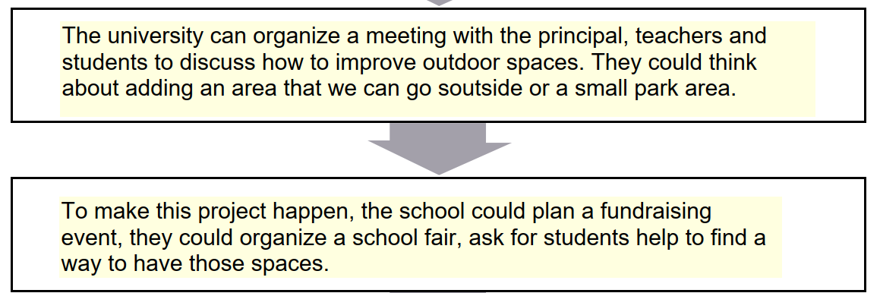

Slide 5
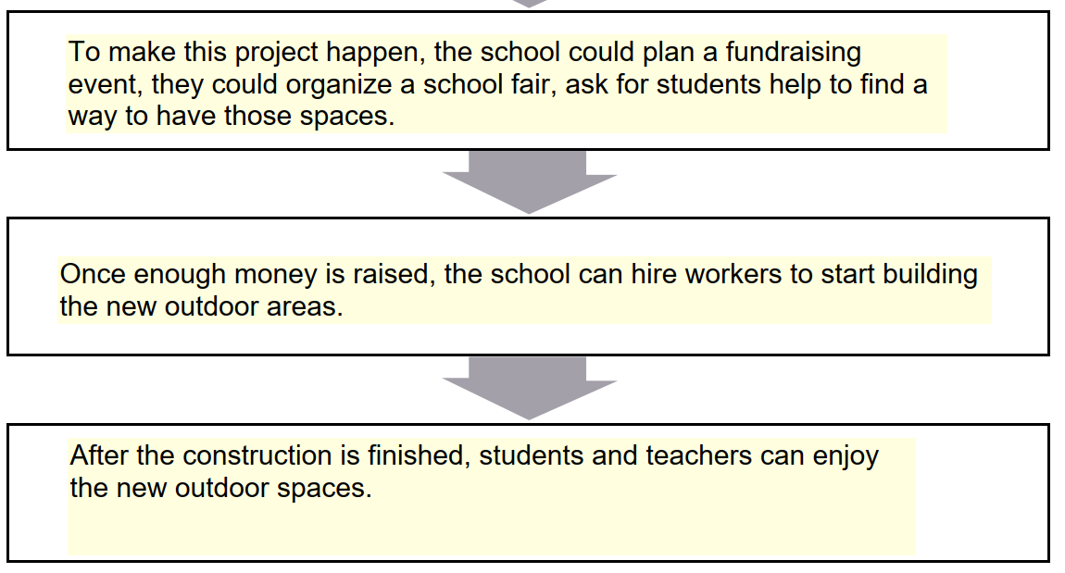

Slide 6
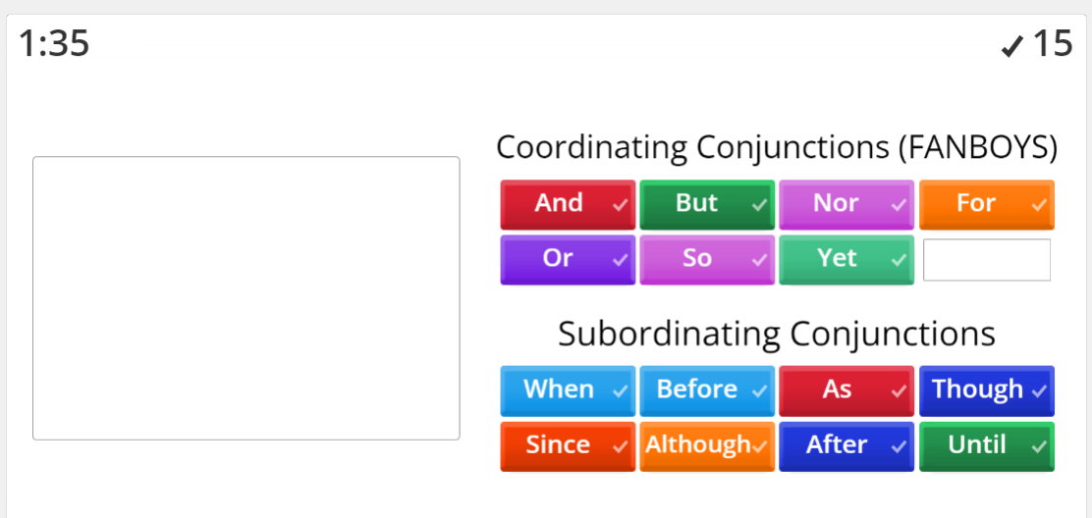
It was very easy thanks to the acronym :D

Slide 7

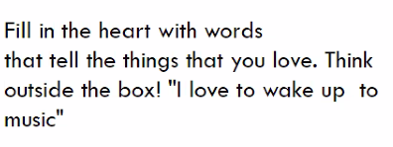
FIRST THINGS FIRST
i love food
i love my family
i like to learn new things
I like watching series
I love my dogs
I like the feeling of nostalgia

Slide 8

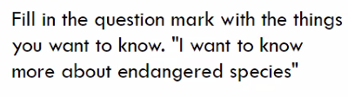
FIRST THINGS FIRST
i want to improve my english skills
I want to get better in my career
I want to be more close to God
I want to be more organized

Slide 9
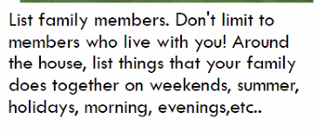
FIRST THINGS FIRST
My dad, José. My mom, Leila. My sister, Janylee and my little brother Haziel.
We are a family of five members.
We don’t hang out frequently, but when we do it, we like to meet new food places that has food that we never ate before.

Slide 10

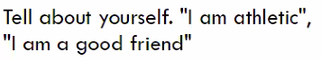
FIRST THINGS FIRST
I am not athletic
(but i want to be)
I can bake
I can cook
I’m good with technology
I can (barely)
speak three
languages
I hate raisins

Slide 11
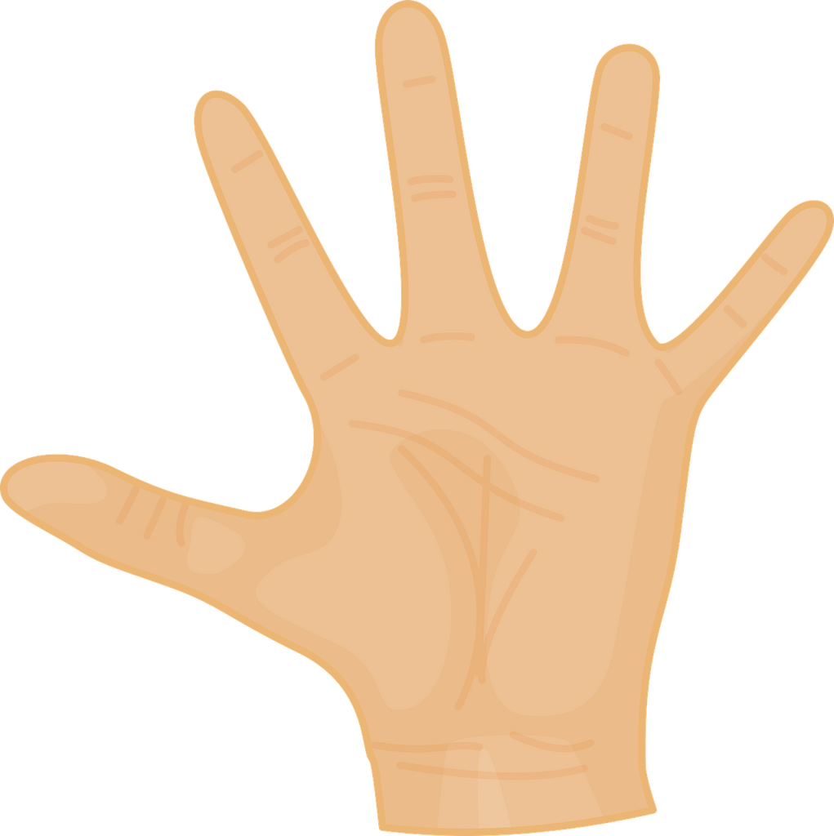
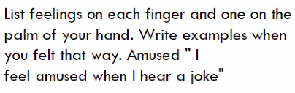
FIRST THINGS FIRST
I feel happy when I
spend time
with my family
I feel excited when
I get a good grade in college.
I feel surprised
when I receive
an unexpected gift.
I feel sad when i
remember the past
I feel happy when I eat desserts

Slide 12
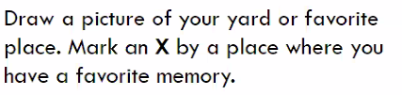
FIRST THINGS FIRST
I don’t really have a favorite place,
but I do have a favorite time, that is the time
when I play with my dogs.
I have five and they are hilarious

